Slide 1
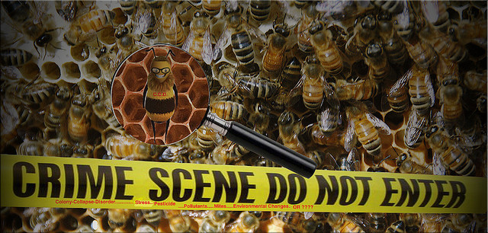
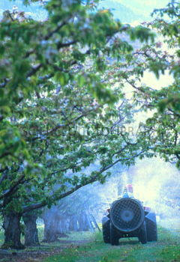
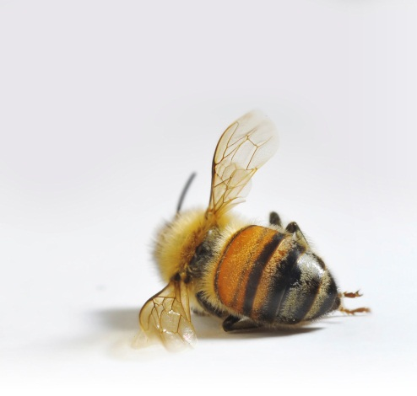
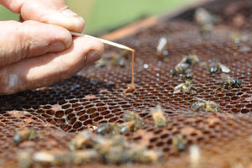
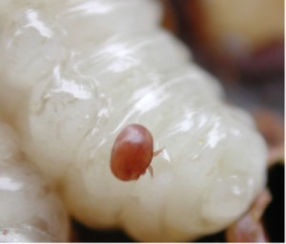

Threats to honeybees & what we can do
(draft slides for educators to edit as needed)
Chemical misuse
Materials produced for the Global Pollination Project & Honeybee Forage Project South Africa, implemented by the South African National Biodiversity Institute.
American Foulbrood
Varroa mite on honeybee larva

Slide 2
Stress on honeybee health in SA
Pests and diseases (American Foulbrood, Varroa mite).
Chemicals such as pesticides.
Global change factors (e.g. land use change & climate change).
Over-working during the pollination season (being moved large distances in short timeframes).
Scarcity of good forage resources.
Many of the stresses that affect honeybees also impact other wild insect pollinators, and therefore any efforts we make at protecting the honeybee should help protect our wild insect pollinators.
(the focus of SANBI project and therefore the focus of the rest of this PowerPoint)

Slide 3
Scarcity of good forage resources
Land use changes (such as urbanisation or deforestation) may lead to habitat degradation and destruction.
Intensified agriculture and forestry practices contribute to:
  loss of surrounding natural vegetation (monocultures).
  planting of nutrient-poor crops and non-flowering cultivars.
Removal of good forage resources, such as some Eucalyptus some indigenous species.

Slide 4
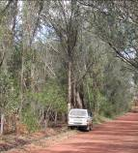
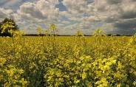
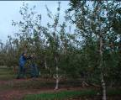
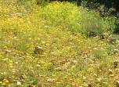
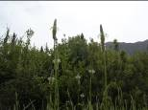
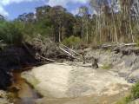
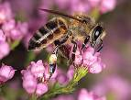
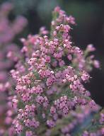
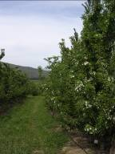
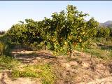
Illustration of forage provision to managed honeybees in the Western Cape as an example of the diversity of forage used during the year
canola
apples
eucalyptus
Weeds (e.g. ramenas)
eucalyptus
eucalyptus
Jan-Feb | Apr - June | Jul-Aug | Sep-Oct | Nov-Dec
Fynbos
pears
citrus
fynbos
Some pollination-dependent crops are not good forage for honeybees, and provide only variable nutrition.
Build-up & Swarm trapping
Honey
Fynbos honey / maintenance
Pollination season

Slide 5
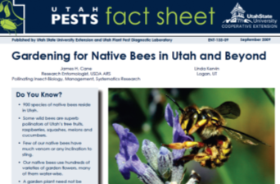
What we can do
The planting of honeybee-friendly plants can help the issue of the scarcity of forage resources.
Campaign for the planting of honeybee-friendly plants in your neighbourhood (e.g. city parks, in gardens, along road verges).
Never kill honeybees or other pollinators with chemicals.
Find out about the fruit and vegetables that you buy (are they in season, have chemicals been applied correctly and in a bee-friendly manner?).
Become a researcher or help researchers. Much research is still needed, e.g. the impacts of climate change; pollination research; hive strength; etc.

