Slide 1
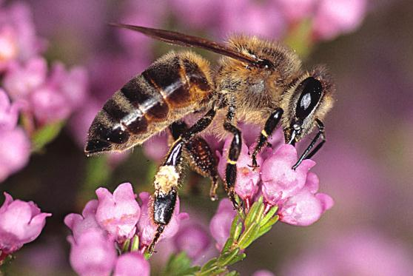
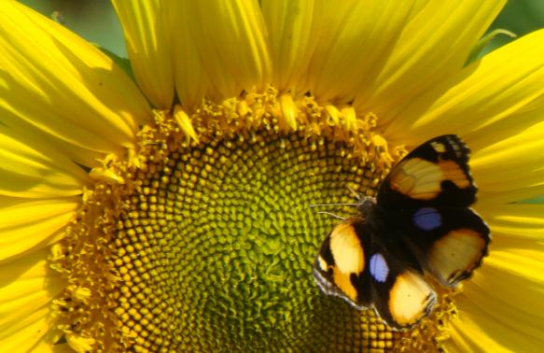
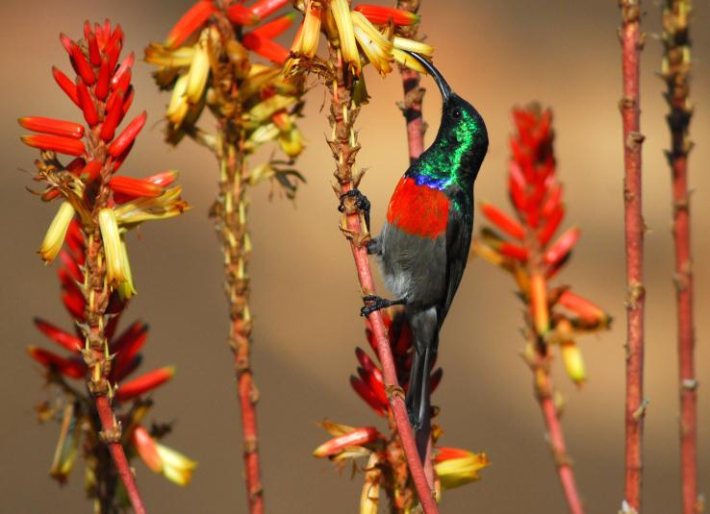

Pollination biology
(draft slides for educators to edit as needed)
Materials produced for the Global Pollination Project & Honeybee Forage Project South Africa, implemented by the South African National Biodiversity Institute.

Slide 2
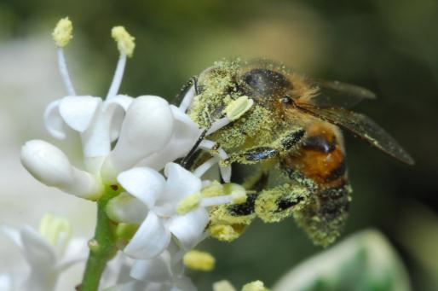
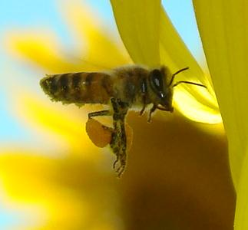
Pollination is the process by which pollen is transferred in the reproduction of plants, thereby enabling fertilisation and the production of fruit and seeds (sexual reproduction).
Abiotic pollination: pollination without the involvement of other living organisms (e.g. wind or water). Only 10% of flowering plants are pollinated without animal assistance.
Biotic pollination: pollination by a pollinator (insects are the most important pollinating animals, but birds, bats and rodents are also pollinators of some plants).

Slide 3
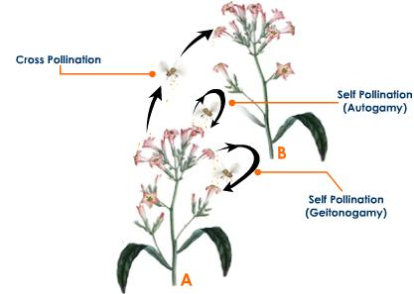
Self- & cross-pollination
CROSS-POLLINATION: the transfer of pollen from an anther of the flower of one plant to a stigma of the flower of another plant.
SELF-POLLINATION: fertilisation by transfer of pollen from the anthers of a flower to the stigma of the same flower (autogamy) or to the stigma of n another flower on the same plant (geitonogamy)
Self: no exchange of genetic material
Cross: exchange of genetic material

Slide 4
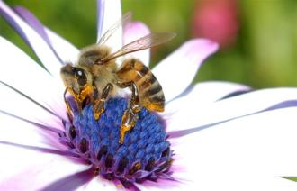
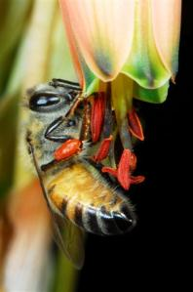
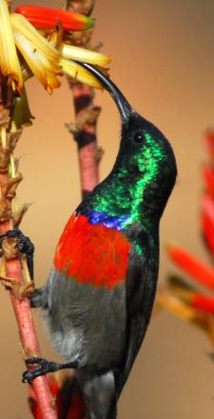
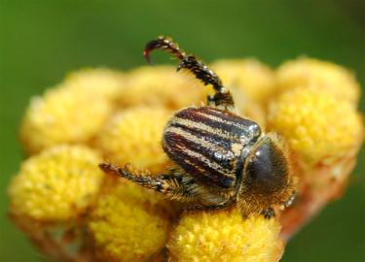
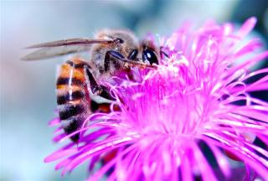
Agents of pollination
Cross-pollination depends on insects visiting flowers of the same species in sequence. To help ensure that this happens, the plants have various characteristics that help pollinators locate the right flowers, including the colour, size, shape and scent of the flowers, as well as the food reward.
Sunbird: tubular, colourful flowers
Honeybee: many varied flower types
Beetles: flat or cup-shaped (big) flowers

Slide 5
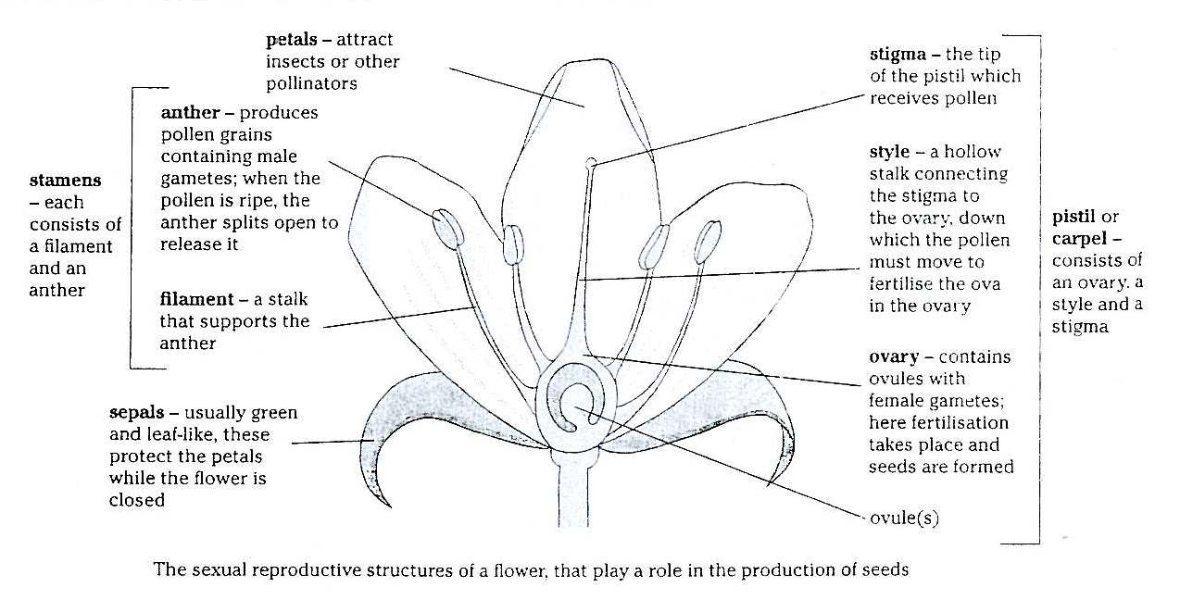
Parts of the flower

Slide 6
