Slide 1
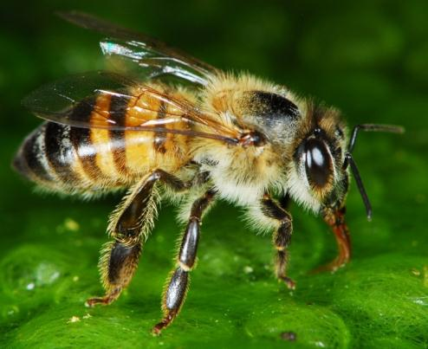
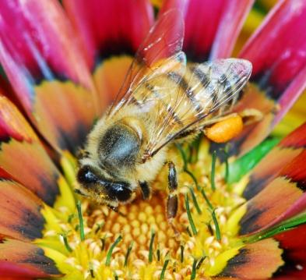
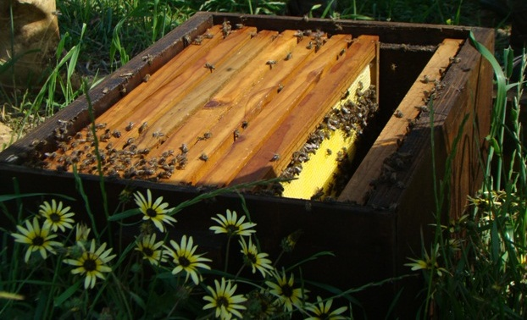
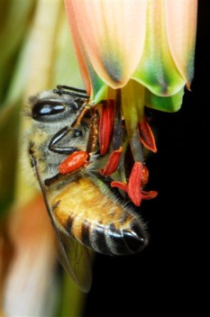
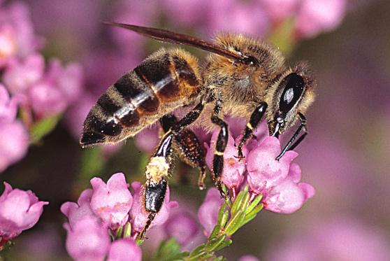
Importance of honeybees & their relationship to our food (draft slides for educators to edit as needed)
Materials produced for the Global Pollination Project & Honeybee Forage Project South Africa, implemented by the South African National Biodiversity Institute.

Slide 2
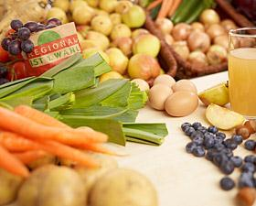
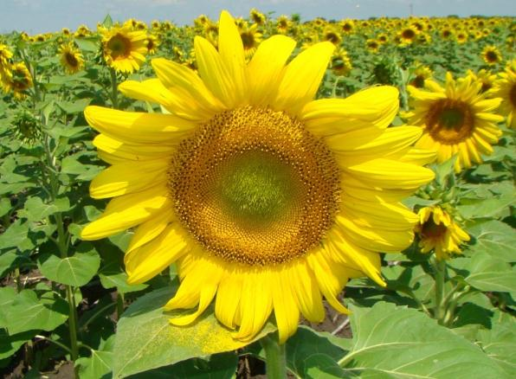
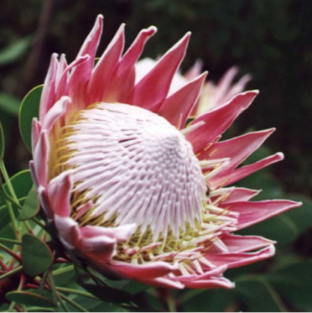
ECOLOGICAL VALUE OF POLLINATION
Valuable in their own right
Part of ecology
HUMAN VALUE OF POLLINATION
Crops for human food + animal fodder
Fibres, wood and other materials
Plant breeding & flowers
Medicines
Aesthetic value

Slide 3
Pollinators and our food
Insect pollination is essential for 35% of global food production. “You can thank an insect pollinator for 1 out of every 3 bites of food you eat!”
Insects pollinate the flowers of the fruit and vegetable plants we rely on for a healthy and balanced diet… (apples, melons, pumpkin, avo’s, etc)
…while most of the staple food plants can self-pollinate or are wind-pollinated (like maize and wheat), or reproduce vegetatively (like potatoes).
A world without insect pollinators would mean a world of far fewer food choices, more expensive food, and vastly different agriculture.

Slide 4
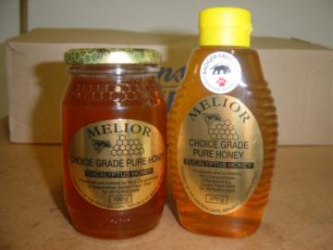
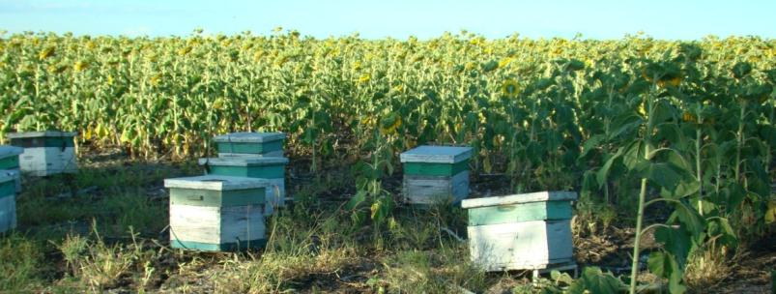
Honeybees
Many commercial pollinator-dependent crops are reliant on the honeybee as their pollinator.
For most South African crops, honeybees are the most economically valuable pollinators because they are:
Very effective pollinators.
Indigenous (i.e. they are naturally found here).
They can be managed in the huge numbers needed to supply the pollination service to our large-scale commercial crops.
Beekeepers supply the pollination service to growers/farmers, as well as harvest the honey from the bees to bottle and sell.

Slide 5
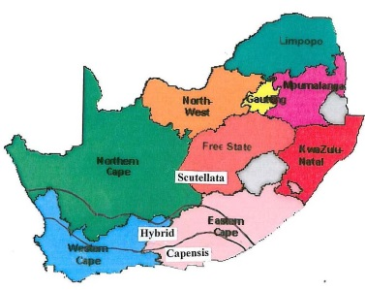
Honeybees in South Africa
Two sub-species: Apis mellifera capensis and A.m. scutellata.
Both good pollinators, especially if handled correctly.
Wild & managed populations are the same, as they are indigenous honeybees; and because beekeepers trap swarms and sometimes managed bees swarm off into the wild.
Eucalyptus flowers probably responsible for >60% of honey production in South Africa.
Some beekeepers migrate 2 500km/yr following honey flows.
87% of colonies in W. Cape used for commercial pollination (~60k hives).
‘New’ threats: Varroa mite, AFB, pesticides, forage limits, theft…
SA honeybees populations may not be as healthy as we believe.

Slide 6
What’s for dinner? Examples of parts of the plant we eat:
Flowers: broccoli, cauliflower.
Fruit: apple, peach, tomato, cucumber, pumpkin, avocado, watermelon, bean.
Stems: sugar!, asparagus, celery, potatoes (modified stem).
Leaves: lettuce, cabbage, tea, Brussels sprouts.
Roots: carrot, sweet potato, radish.
Seeds: nuts, maize/corn, peas, rice.

Slide 7
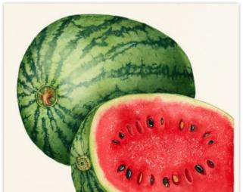
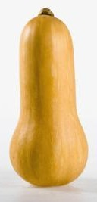
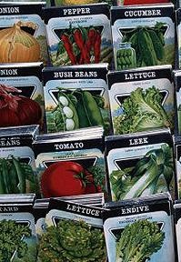
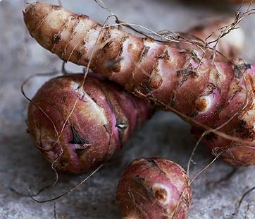
Know your veg pollination!
Pollination requirements of vegetables can be discussed according to what part of the plant is eaten:
If the ‘vegetable’ is a ‘fruit’ then pollination is required both for the production of the vegetable AND for seed production; e.g. tomatoes, peppers, eggplant, peas, beans, pumpkins, marrows, butternut, cucumbers, etc.
If the ‘vegetable’ is in the form of leaves or shoots (e.g. lettuce, cabbage, kohlrabi, broccoli, Brussels sprouts, spinach, Swiss Chard, leeks, onions, etc.) or is a ‘storage root’ (e.g. carrots, beetroot, turnip, parsnip, etc.) then pollination is not required or desired for the production of the vegetable, but ONLY for seed production.
If the ‘vegetable’ is a ‘storage stem’ then pollination is not required for EITHER the production of the vegetable or seed because seed is not required for propagation; e.g. potatoes, Jerusalem artichokes.

